Slide 1
Text Classification using Active Learning
By Samyak Jain (41896302717)
Priyam Gupta (42296302717)
Atharv Mittal (41796302717)
Mentor – Dr. Adeel Hashmi

Slide 2
Introduction
Data is the fuel of machine learning applications and therefore has been steadily increasing in value.
In many settings an abundant amount of unlabeled data is produced, but in order to use such data in supervised machine learning, one has no choice but to provide labels. This usually entails a manual labeling process, which is often non-trivial and can even require a domain expert.
Moreover, this is time-consuming and rapidly increases monetary costs, thereby quickly rendering this approach infeasible. Even if an expert is available, it is often impossible to label each data item due to the vast size of modern datasets. This especially impedes the ﬁeld of Natural Language Processing (NLP), in which both the dataset and the amount of text within each document can be huge, resulting in unbearable amounts of annotation efforts for human experts.

Slide 3
Abstract
In many real world machine learning tasks, labeled training examples are expensive to obtain, while at the same time there is a lot of unlabeled examples available. One such class of learning problems is text classification. Active learning strives to reduce the required labeling effort while retaining the accuracy by intelligently selecting the examples to be labeled. However, very little comparison exists between different active learning methods. The effects of the ratio of positive to negative examples on the accuracy of such algorithms also received very little attention.
So we aim to classify the text given into some keywords so that it would become more understandable and will give much insight into what’s happening.

Slide 4
Active Learning
Active learning is a special case of machine learning in which a learning algorithm can interactively query a user (or some other information source) to label new data points with the desired outputs. In statistics literature, it is sometimes also called optimal experimental design.
There are situations in which unlabeled data is abundant but manual labeling is expensive. In such a scenario, learning algorithms can actively query the user/teacher for labels. This type of iterative supervised learning is called active learning

Slide 5
Why Active Learning?
Active Learning (AL) aims to reduce the amount of data annotated by the human expert. It is an iterative cyclic process between an oracle (usually the human annotator) and an active learner. In contrast to passive learning, in which the data is simply fed to the algorithm, the active learner chooses which samples are to be labeled next. The labeling itself, however, is done by a human expert, the so-called human in the loop.
Having received new labels, the active learner trains a new model and the process starts from the beginning. Using the term active learner, we refer to the composition of a model, a query strategy, and a stopping criterion. In this work the model is w.l.o.g. a text classiﬁcation model, the query strategy decides which instances should be labeled next, and the stopping criterion deﬁnes when to stop the AL loop.

Slide 6
Scenarios of Active Learning
Pool-based, in which the learner has access to the closed set of unlabeled instances, called the pool.
Stream-based, where the learner receives one instance at a time and has the options to keep it, or to discard.
Membership Query Synthesis, in which the learner creates new artiﬁcial instances to be labeled.
If the pool-based scenario operates not on a single instance, but on a batch of instances, this is called batch-mode AL.
***Throughout this work we assume a pool-based batch-mode scenario because in a text classiﬁcation setting the dataset is usually a closed set, and the batch-wise operation reduces the number of retraining operations, which cause waiting periods for the user.

Slide 7
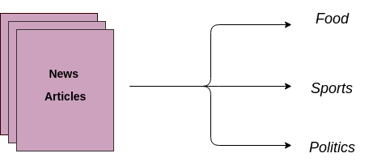
Introduction to Text Classification
Text classification is a supervised learning task for assigning text document to one or more predefined classes/topics. These topics are determined by a set of training documents. In order to construct a classification model, a deep learning algorithm was used. Training data is often a set of full-text documents. The training model is used to predict a class for new coming document. In this paper, we propose a text classification approach based on Deep Learning algorithm “Active Learning”

Slide 8

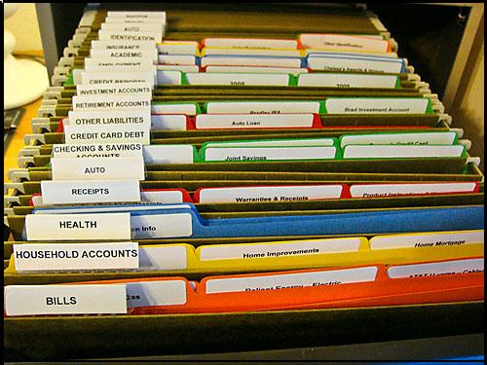
AUTOMATIC TEXT CLASSIFICATION
A FEW HOURS ONLY
MANUAL TEXT CLASSIFICATION
TAKES YEARS

Slide 9

Technologies and Algorithms
Python
Deep Learning
Active Learning
Scikit-Learn
Keras
Pandas

Slide 10
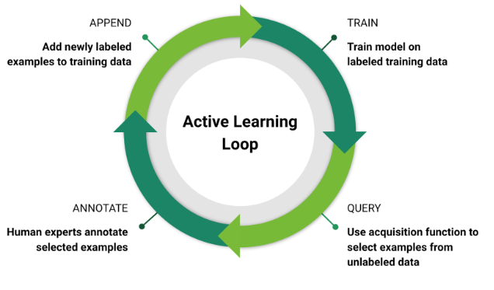
Introduction to Text Classification
Methodology

Slide 11
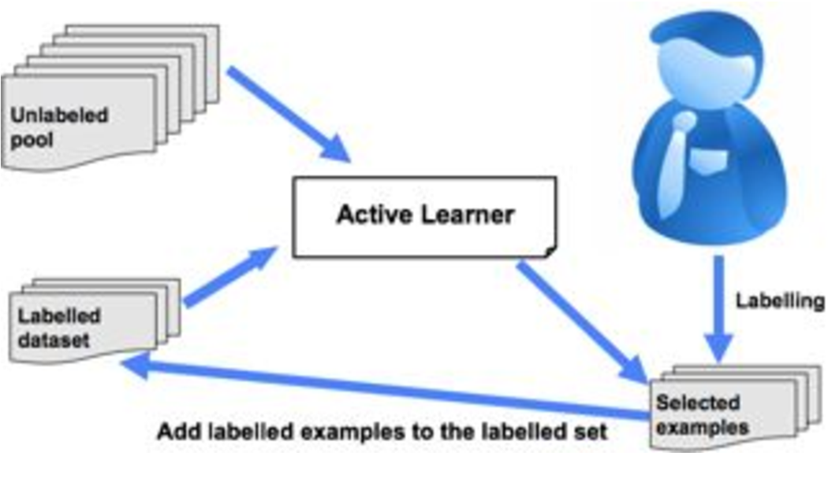

Slide 12
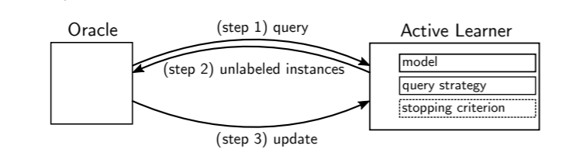
Active Learning Process

Slide 13
Explanation
The goal of AL is to create a model using as few labeled instances as possible, i.e. minimizing the interactions between the oracle and the active learner. The AL process is as follows:
The oracle requests unlabeled instances from the active learner (query, see step 1), which are then selected by the active learner (based on the selected query strategy) and passed to the oracle (see step 2).
Subsequently, these instances are labeled by the oracle and returned to the active learner (update, see step 3).
After each update step the active learner’s model is retrained, which makes this operation at least as expensive as a training of the underlying model. This process is repeated until a stopping criterion is met (e.g., a maximum number of iterations or a minimum threshold of change in classification accuracy)

Slide 14
Query Strategies
The most important component for AL is the query strategy. In the introduction we claimed that a large fraction of query strategies are uncertainty-based.
The most common AL query strategies based on a strategy’s input information, which denotes the numeric value(s) a strategy operates on. In our taxonomy the input information can be either random or one of data, model, and prediction.
These categories are ordered by increasing complexity and are not mutually exclusive. Obviously, the model is a function of the data, as well as the prediction is a function of model and data, and moreover, in many cases a strategy use multiple of these criteria.
In such cases we assign the query strategy to the most speciﬁc category (i.e. prediction-based precedes model-based, which in turn precedes data-based).

Slide 15
Types of Query Strategies
Data-based strategies have the lowest level of knowledge, i.e. they only operate on the raw input data and optionally the labels of the labeled pool. We categorize them further into 1)strategies relying on data-uncertainty, which may use information about the data distribution, label distribution, and label correlation, and 2) representativeness, which tries to geometrically compress a set of points, by using fewer representative instances to represent the properties of the entirety.
Model-based The class of model-based strategies has knowledge about both the data and the model. These strategies query instances based on measure provided by the model given an instance.
Prediction-based strategies select instances by scoring their prediction output. The most prominent members of this class are prediction-uncertainty-based and disagreement-based approaches.

Slide 16
Models
We reported two text classiﬁcation models as representatives of classical and deep learning approaches respectively which were fast to train and also had good performance on text classiﬁcation:
Multinomial Naive Bayes (MNB)
FastText.zip (FTZ)
The FTZ model provides results competitive with VDCNNs (a 29 layer CNN) but with over 15,000× speedup. This allowed us to conduct a thorough empirical study on large datasets.
Multinomial Naive Bayes(MNB)with TF-IDF features is a popularly claimed baseline for text classiﬁcation.
We used Scikit-Learn implementation for MNB and original implementation for FastText.zip (FTZ)

Slide 17
Literature Surveys
A Survey of Active Learning for Text Classification
An Empirical Study of Active Learning for Text Classification
Active Learning Strategies for Multi-Label Text Classification
Active Learning Approaches for Labeling Text
Text Classification with Active Learning
https://docs.google.com/document/d/1LJ-RkmMIc5drZT08H6eyZq_7Cb1S_3Ol_hCOniHR5A4/edit?usp=sharing

Slide 18


